Slide 1


Name: Hamid Alibeiki
Date: 07 – 04- 2023
Github : https://github.com/hamidyazd/SpaceX-Capstone

Slide 2

Outline
Executive Summary
Introduction
Methodology
Results
Conclusion
Appendix

Slide 3
Executive Summary
Summary of methodologies
Data Collection (API – Web Scraping)
Data Wrangling
Exploratory Data Analysis ( SQL – Data Visualization)
Interactive Visual Analytics ( Folium)
ML Prediction
Summary of all results
Exploratory Data Analysis result
Interactive analytics in screenshots
Predictive Analytics result

Slide 4
Introduction
Project background and context
Space X company said that Falcon 9 rocket launches by 62 million dollars cost; other companies cost is 165 million dollars. The main reason of this gap is because of reusing of the first stage by Space X. So, if we can predict the success of landing of the first stage, we can calculate the launch's cost. This results will be useful for company wants to be competitor of space X company. I want to predict the landing successfulness for the first stage by designing a machine learning method.
Problems you want to find answers
What are the items for a successful landing?
What are the relations between various features which that affect the success rate of a successful landing?
What are the conditions for a ensure successful landing?

Slide 5

Section 1

Slide 6
Methodology
Executive Summary
Data collection methodology:
Space X Rest API
Web Scrapping from Wikipedia
Perform data wrangling
One Hot Encoding data fields for ML & data cleaning of missed values and irrelevant columns.
Perform exploratory data analysis (EDA) using visualization and SQL
Perform interactive visual analytics using Folium and Plotly Dash
Perform predictive analysis using classification models
LR, SVM, DT and KNN models have been built & evaluated to find the best classifier.

Slide 7
Data Collection
Describe how data sets were collected.
The datasets was collected:
Space X launch data that is gathered from the Space X REST API.
This API give us data for launches, included information of rocket used, payload delivered, launch and landing specifications, and landing outcome.
The SpaceX REST API endpoints, or URL, starts here api.spacexdata.com/v4/.
Another data source for obtaining the Falcon 9 Launch data is web scraping from Wikipedia using BeautifulSoup.
Returns SpaceX data in Json
Normalize data into csv file
Use Space X Rest API
Ready for data consolidation &wrangling
Get HTML Response from wikipedia
Extract data using
beautifulsoup
Normalise data into csv file

Slide 8
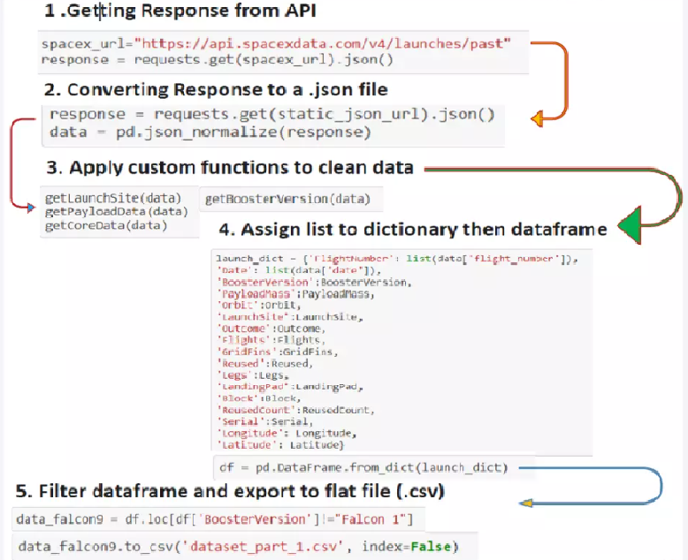
Data Collection – SpaceX API
Data collection by Space X REST calls
Place your flowchart of SpaceX API calls here

Slide 9
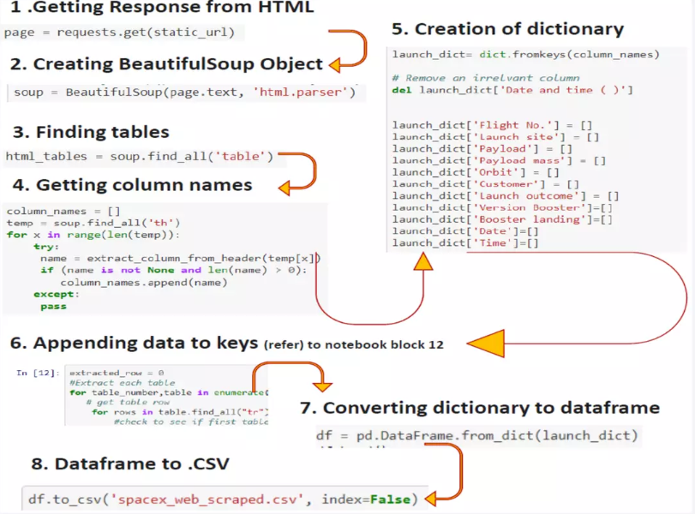
Data Collection - Scraping
Web scrapping: Wikipedia
Place your flowchart of web scraping here

Slide 10
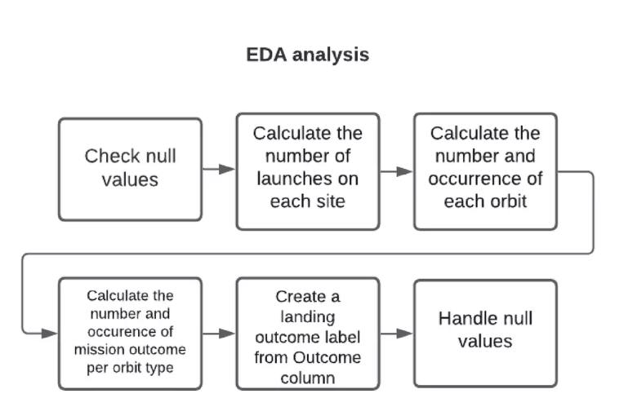
Data Wrangling

Slide 11
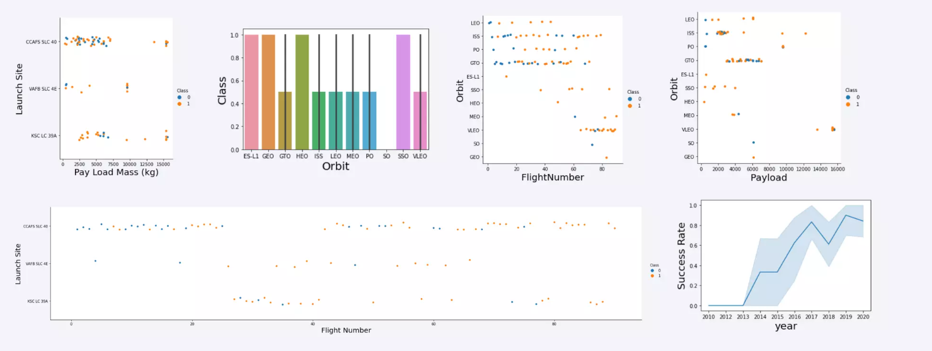
EDA by Data Visualization

Slide 12
EDA with SQL
Displaying the unique launch site's names in space mission
Displaying 5 records where launch sites begin with the string 'KSC
Displaying the total payload mass carried by boosters launched by NASA (CRS)
Displaying average payload mass carried by booster version F9 v1.1
Listing the date where the successful landing outcome in drone ship was achieved.
Listing the names of the boosters which have success in ground pad and have payload mass between 4000 up to 6000.
Listing the number of successful & failure mission outcomes
Listing the names of the booster versions carried the maximum payload mass
Listing the records displayed the month names, successful landing outcomes in ground pad booster versions, launch site for the months in 2017
Ranking the count of successful landing outcomes between 2010 06 04 & 2017 03 20 in descending order.

Slide 13
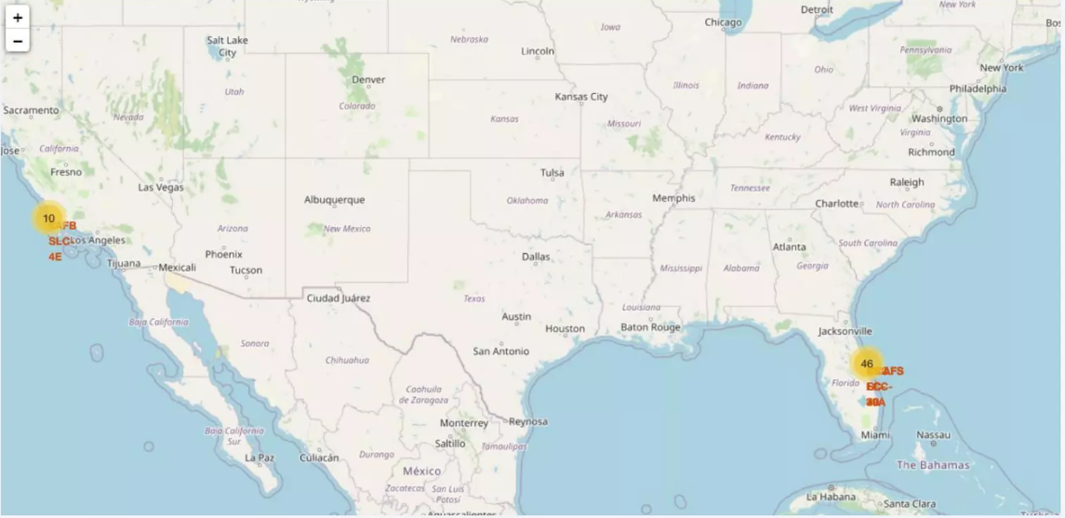
Build an Interactive Map with Folium
Map markers added to map to finding an optimal location for building a launch site.

Slide 14
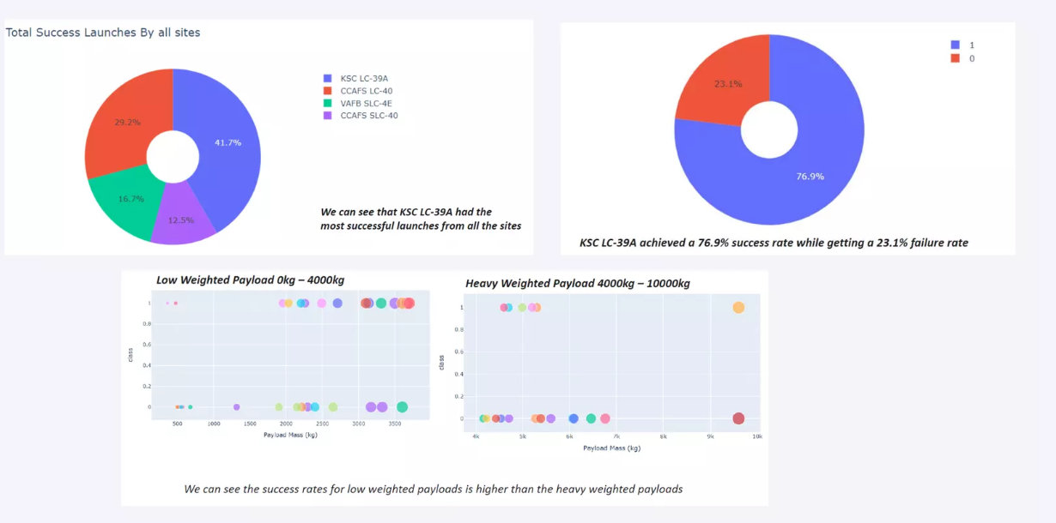
Build a Dashboard with Plot ly Dash

Slide 15
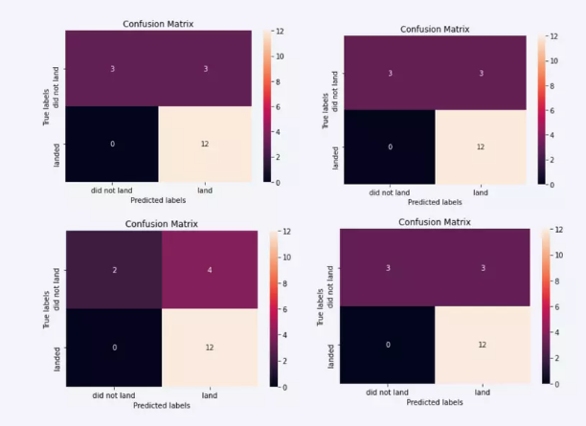
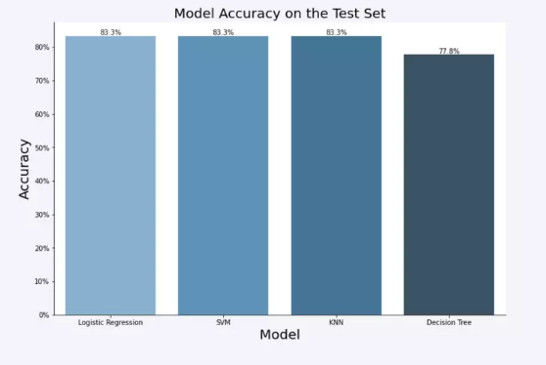
Predictive Analysis (Classification)
.
The KNN, SVM & Logistic Regression model achieved the highest accuracy at 83.3%, but SVM performs the best in terms of Area Under the Curve at 0.958!

Slide 16
Results
The KNN, SVM & Logistic Regression models are the best in terms of prediction accuracy for our dataset.
Low weighted payloads perform better heavier payloads than!
The success rates for Space X launches is directly proportional time in years eventually perfect the launches.
KSC LC 39A had the most successful launches from all the sites we considered.
Orbit GEO,HEO,SSO,ES L1 has the best Success Rate.

Slide 17

Section 2

Slide 18
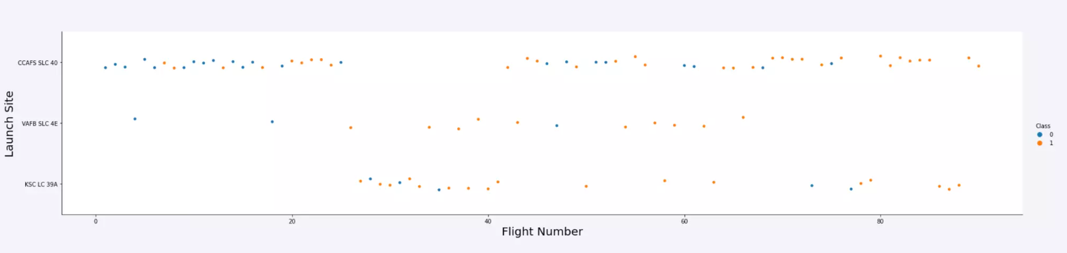
Flight Number VS Launch Site
Launches from the site of CCAFS SLC 40 are launches form other sites.
significantly higher lunches from other sites than.

Slide 19
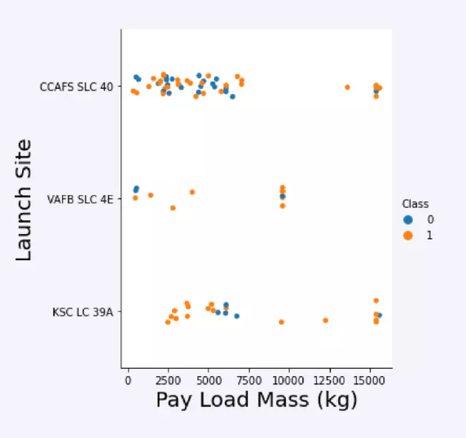
Payload VS Launch Site
The majority of IPay Loads with lower Mass launched from CCAFS SLC 40.

Slide 20
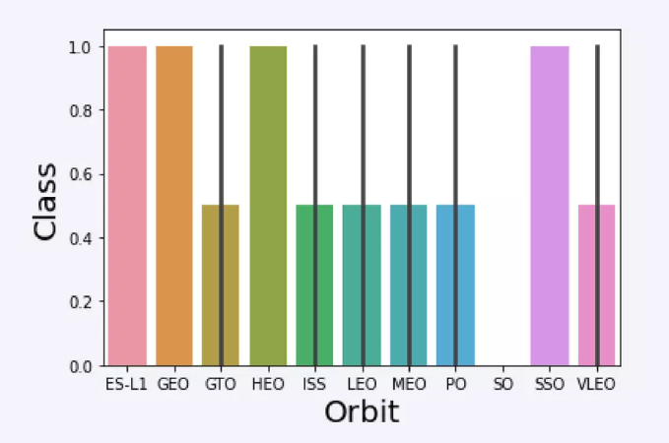
Success Rate vs. Orbit Type
The orbit types SSO, HEO, ES-L1 & GEO have the highest success rate.

Slide 21
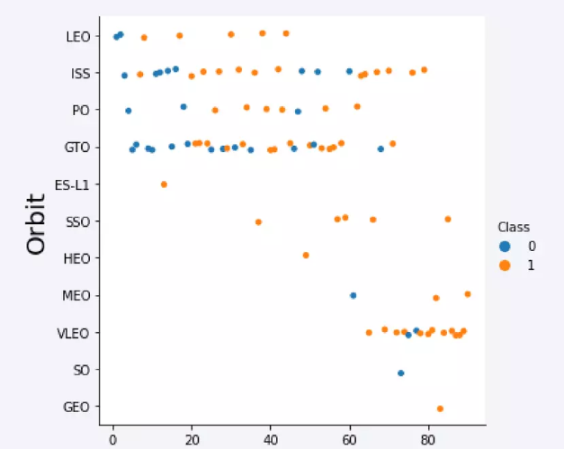
Flight Number vs. Orbit Type
A trend shows a shifting to VLEO launches in recent years.

Slide 22
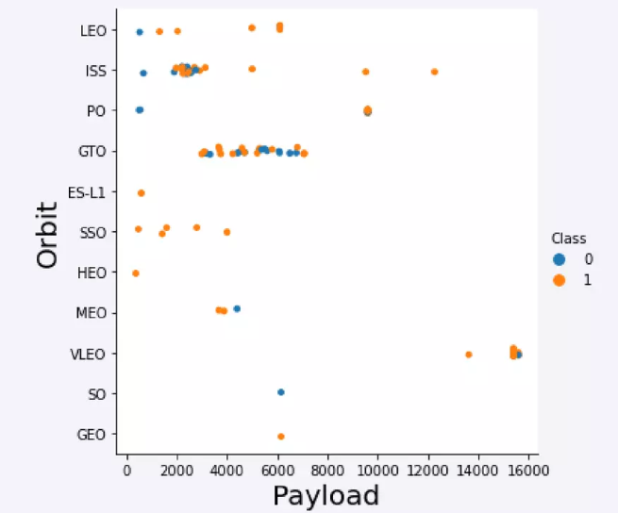
Payload vs. Orbit Type
﻿Strong correlation between ISS & Payload at the range around 2000, and GTO at the range of 4000-8000 as well.

Slide 23
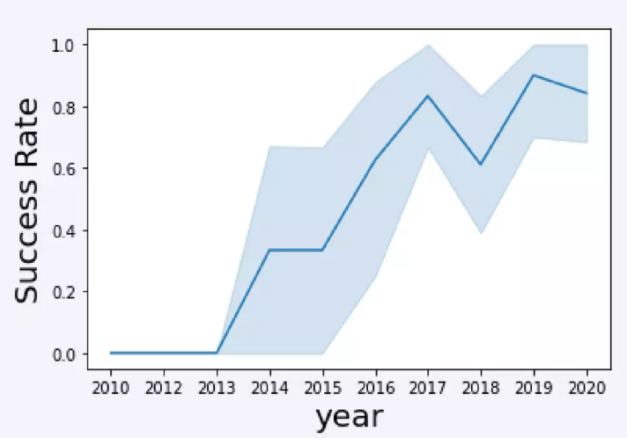
Launch Success Yearly Trend
Launch success rate has increased significantly since 2013 & established since 2019, because of advance in technology as well as lessons learned.

Slide 24
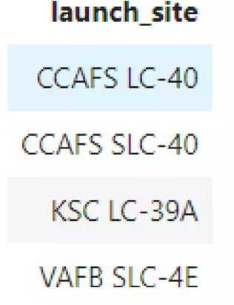
All Launch Site Names
﻿%sql select distinct (LAUNCH_SITE) from SPACEXTBL

Slide 25
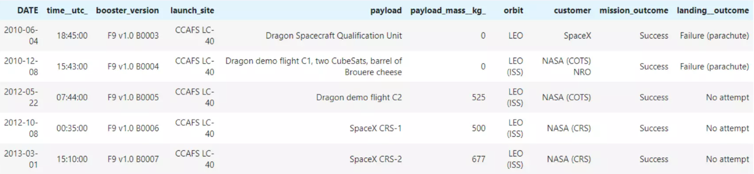
Launch Site Names Begin with 'CCA'
%sql select from SPACEXTBL where LAUNCH_SITE like 'CCA%' limit 5

Slide 26
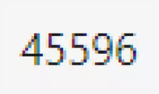
Total Payload Mass
%sql select sum(PAYLOAD_MASS_KG_) from SPACEXTBL where CUSTOMER = 'NASA (CRS)'

Slide 27
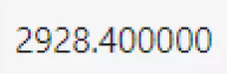
Average Payload Mass by F9 v1.1
%sql select avg (PAYLOAD_MASS_KG_) from SPACEXTBL where BOOSTER VERSION = 'F9 v1.1'

Slide 28

First Successful Ground Landing Date
%sql select min(DATE) from SPACEXTBL where Landing__Outcome = 'Success (ground pad)'

Slide 29
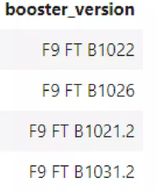
Successful Drone Ship Landing with Payload 4000-6000
%sql select BOOSTER_VERSION from SPACEXTBL where Landing Outcome
= 'Success (drone ship)' and PAYLOAD_MASS__KG_> 4000 and
PAYLOAD_MASS_KG_< 6000

Slide 30
Total Number of Successful and Failure Mission Outcomes
%sql select count(MISSION_OUTCOME) from SPACEXTBL where
MISSION OUTCOME = 'Success' or MISSION_OUTCOME = 'Failure (in flight)'
100

Slide 31
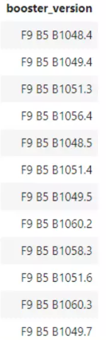
Boosters Carried Maximum Payload
%sql select BOOSTER_VERSION from SPACEXTBL where
PAYLOAD_MASS_KG_ = (select max(PAYLOAD_MASS_KG_) from SPACEXTBL)

Slide 32
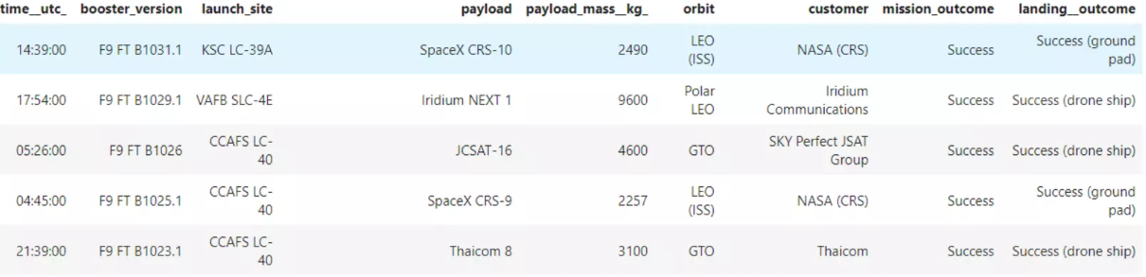
2015 Launch Records
﻿%sql select * from SPACEXTBL where Landing Outcome like 'Success%' and (DATE between '2015-01-01' and '2015-12-31') order by date desc…

Slide 33
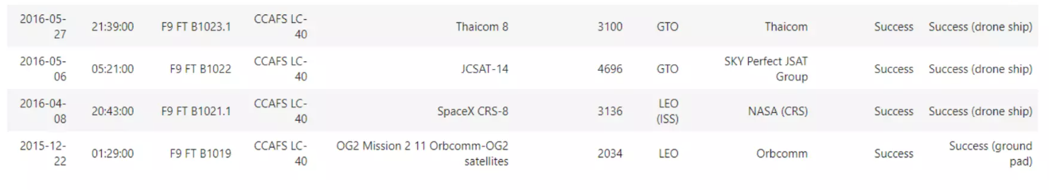
Rank Landing Outcomes Between 2010-06-04 & 2017-03-20
%sql select * from SPACEXTBL where Landing Outcome like 'Success%' and (DATE between '2010-06-04' & '2017-03-20') ordered by date desc…

Slide 34

Section 3

Slide 35
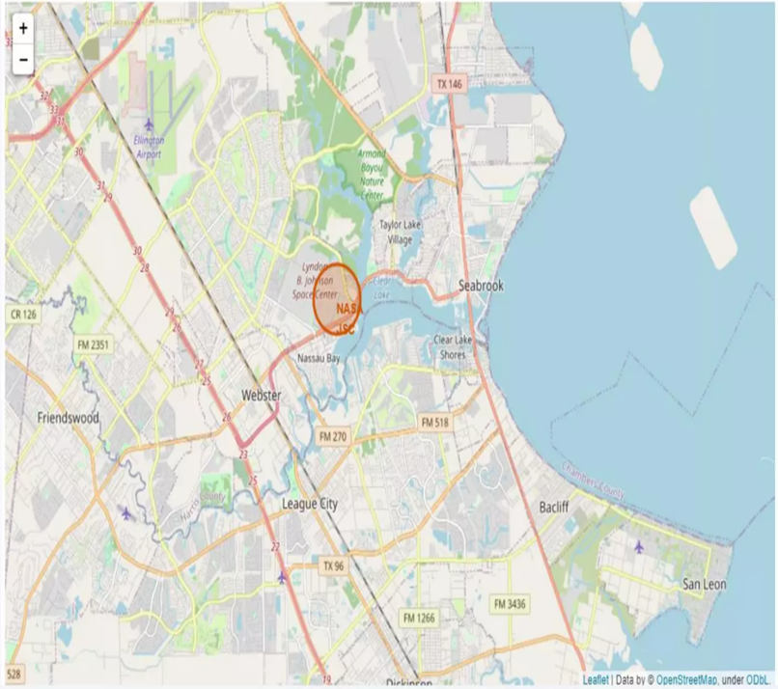
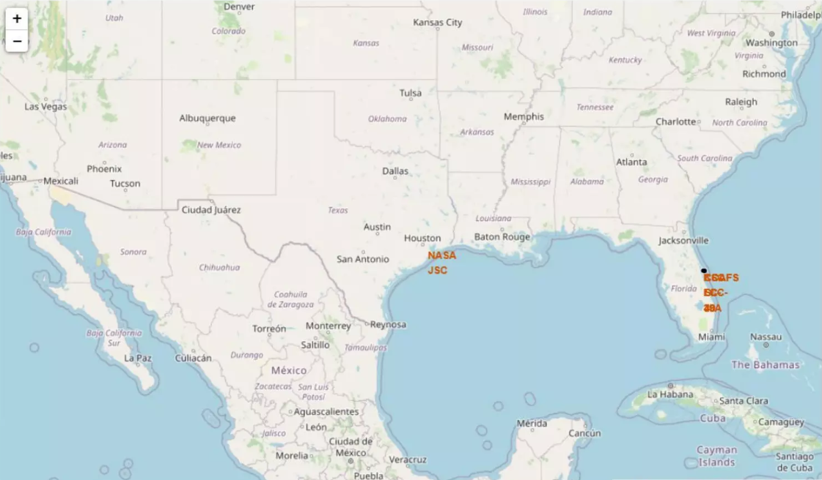
Folium Map 1

Slide 36
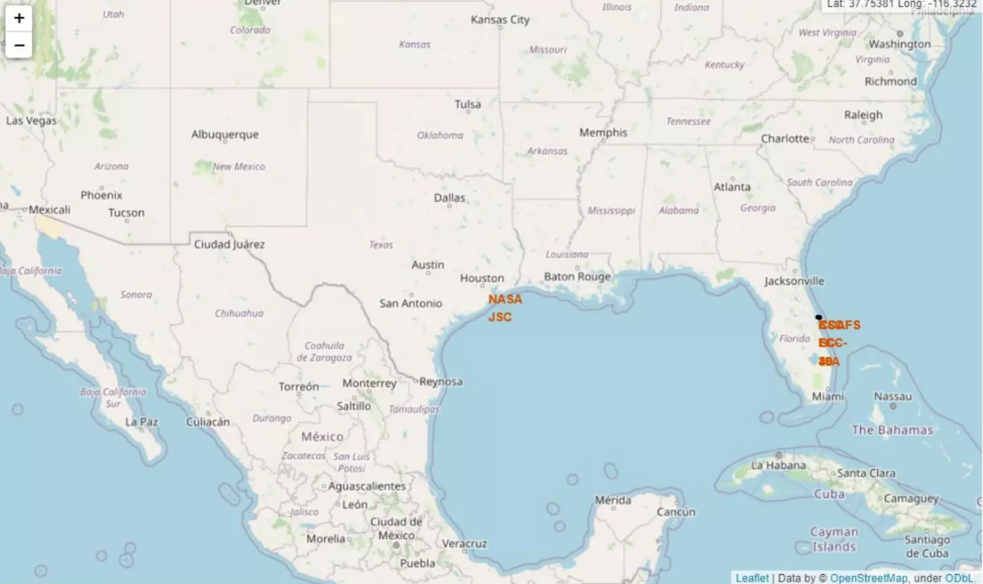
Folium Map 2

Slide 37

Section 4

Slide 38
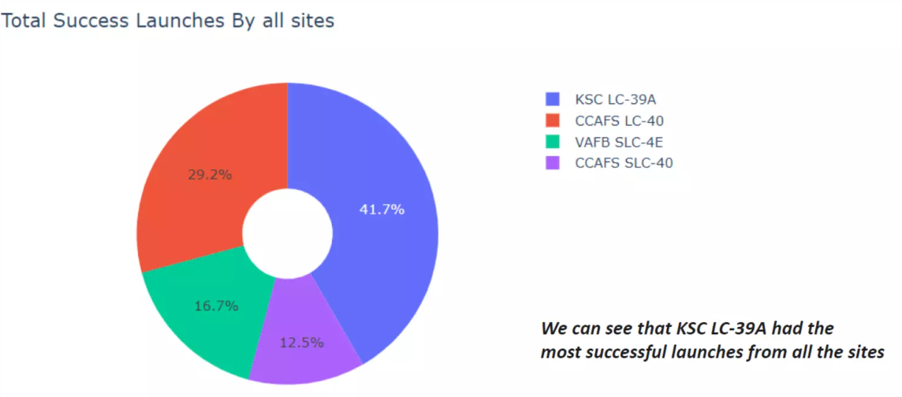
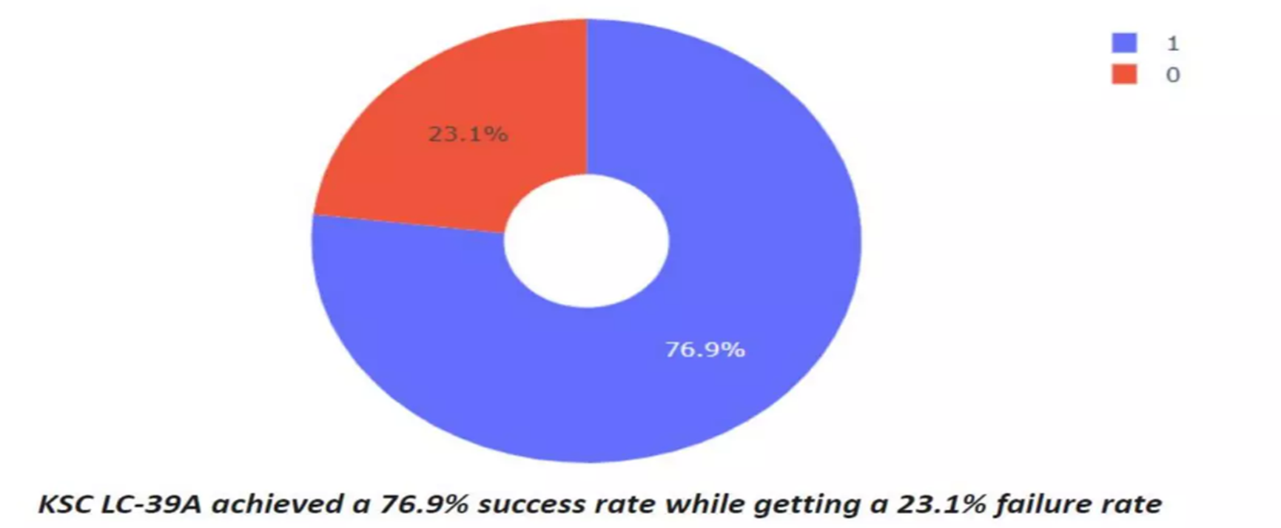
Dashboard

Slide 39
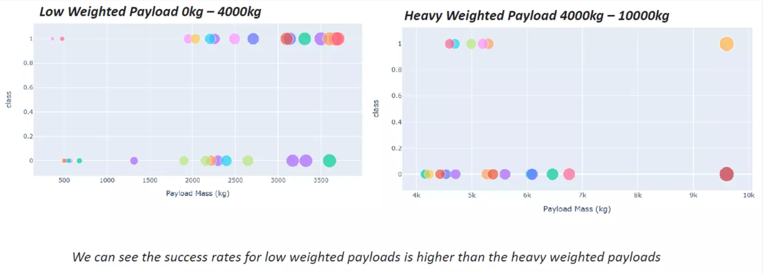
Dashboard

Slide 40

Section 5

Slide 41
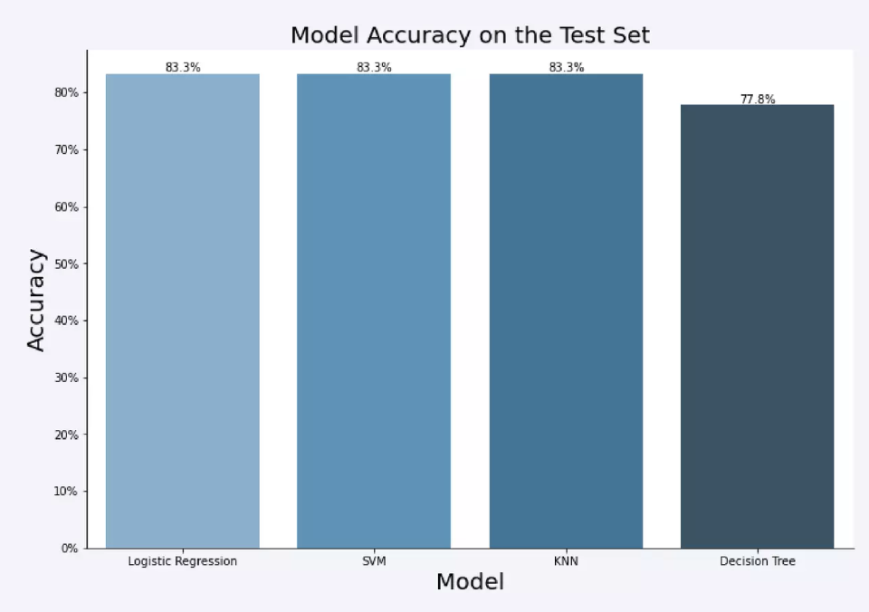
Classification Accuracy

Slide 42
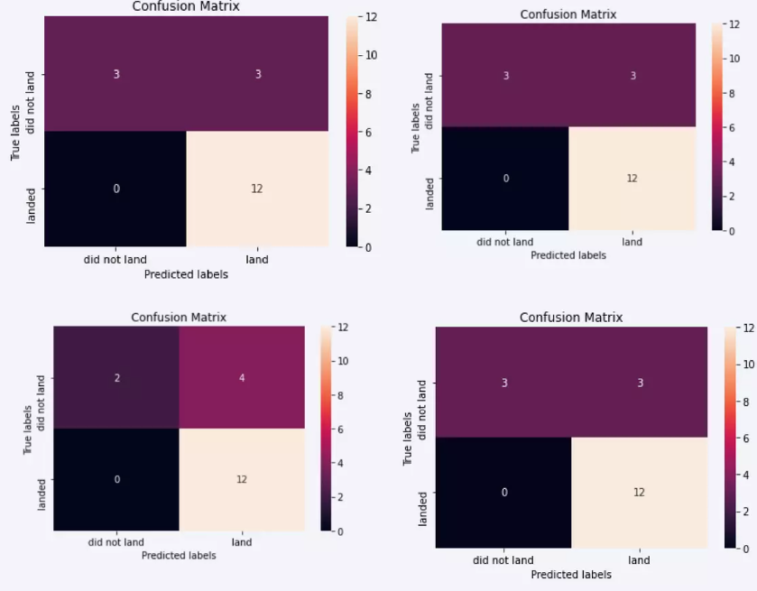
Confusion Matrix

Slide 43
Conclusions
The KNN, SVM & Logistic Regression models are the best in prediction accuracy for this dataset.
Low weighted payloads perform better heavier payloads than.
The success rates for Space X launches is directly proportional time in years they will eventually perfect the launches.
The most successful launches from all the sites was by KSC LC 39A.
Orbit HEO, SSO, GEO & ES L1 has the best Success Rate.

Slide 44


